Slide 1
Balloon Shield Design
Microprocessor Systems
March 13, 2026
Lauren Ooghe

Slide 2
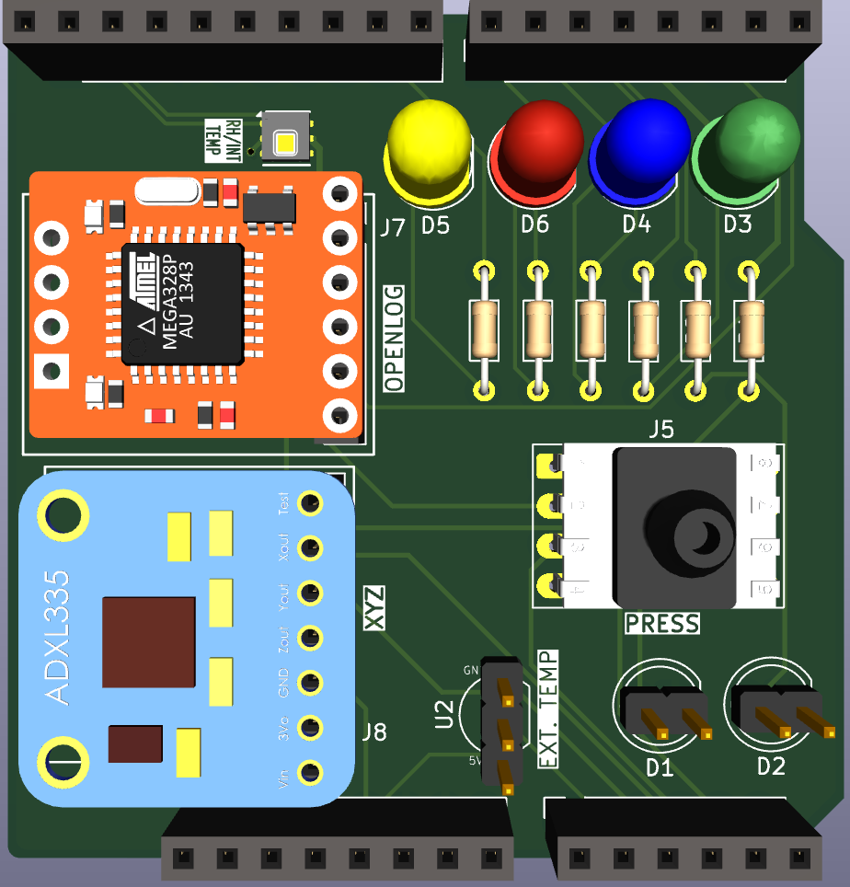
Objectives
The purpose of this project is to apply technical skills in researching and developing alternative solutions to a design.
This project incorporates an electrical system used in a weather balloon that retrieves data parameters such as pressure, humidity, temperature, and position.

Slide 3
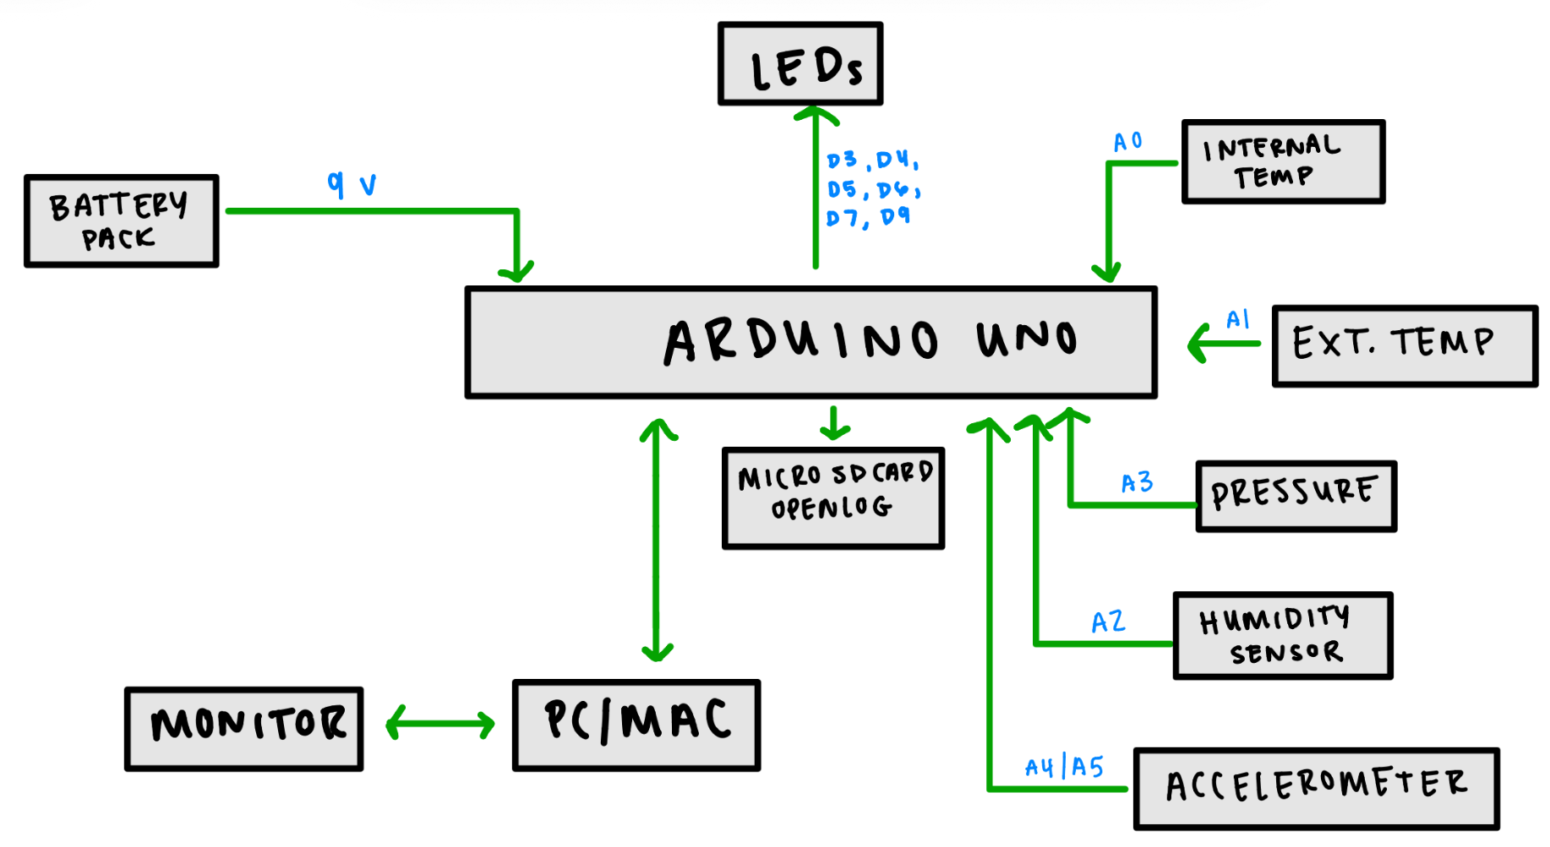
Design Stage: Phase 1

Slide 4
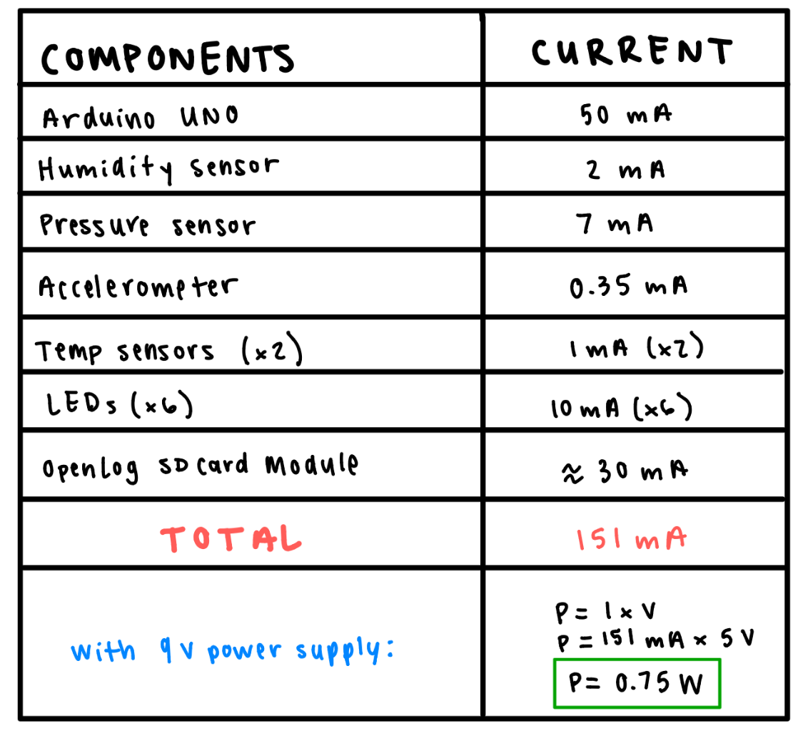
Phase 1: Power Consumption
Estimated current draw for each component of original design
Receiving 5 V from the Arduino
The 9 V battery is regulated by the Arduino’s onboard regulator.
This energy is lost or ‘wasted’ in the form of heat.

Slide 5
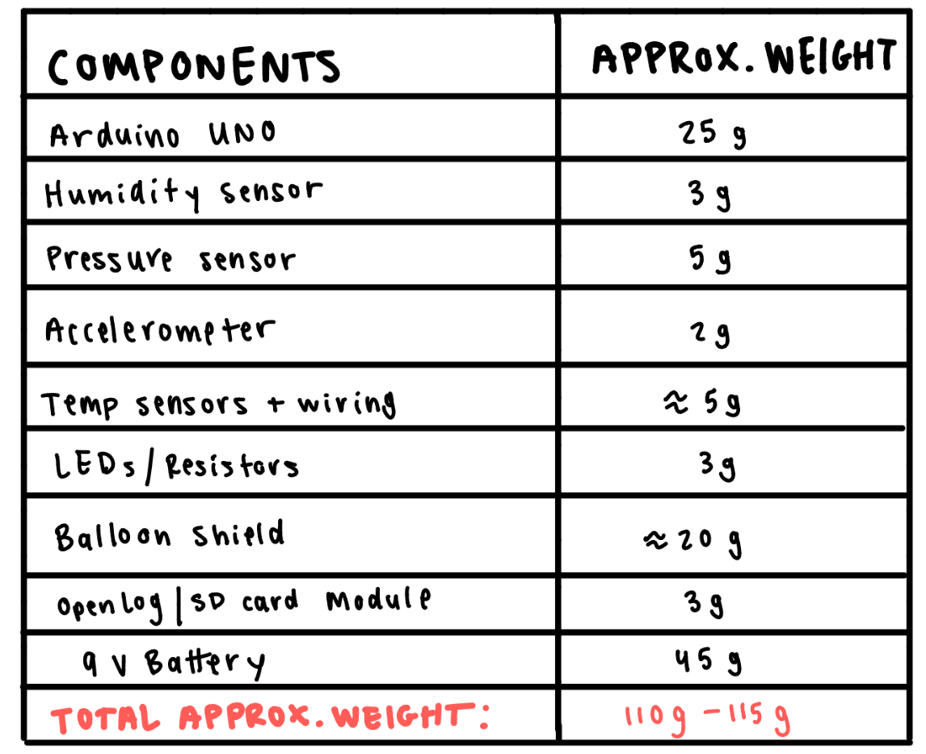
Phase 1: Total Weight Approx.
Estimated weight in grams of each onboard electrical component.

Slide 6
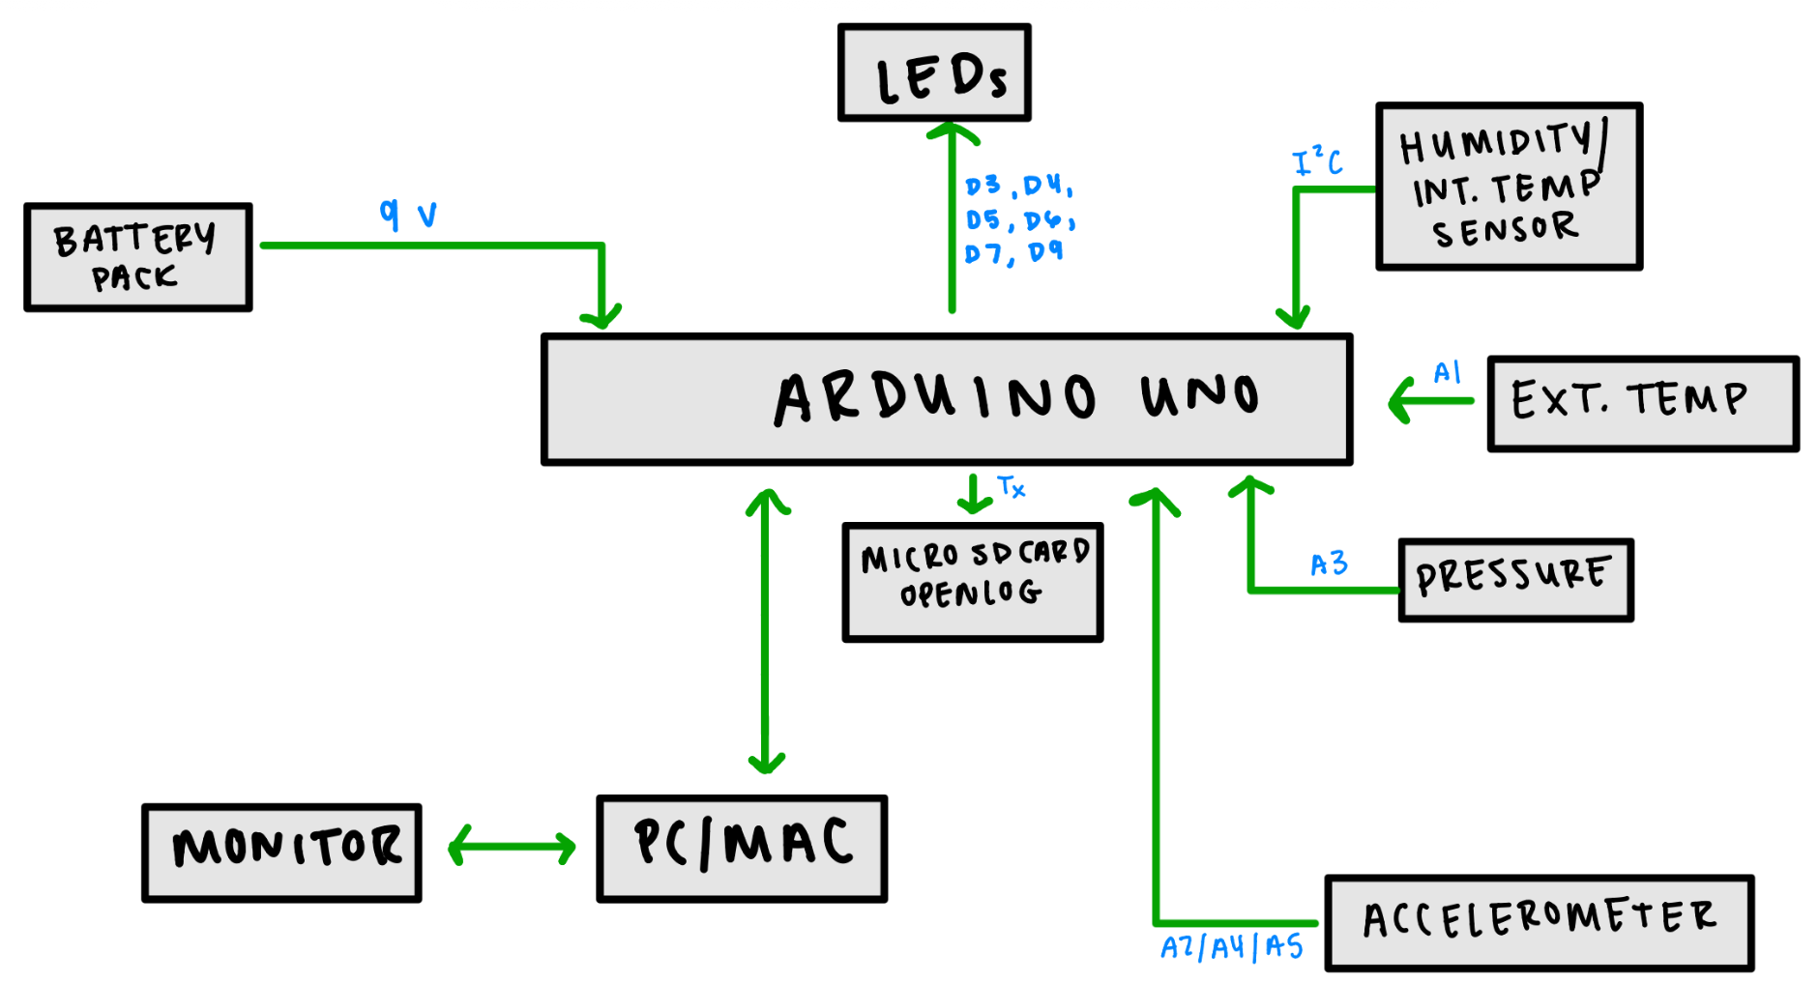
Design Stage: Phase 2

Slide 7
Design Implementation
Overview of design stage.
Component
Search
Schematic Design
PCB Layout
Finalizing Design
Main goal to replace the humidity sensor
Found Honeywell HDC-1080 SMD
Also changed the accelerometer for lower cost
Following the block diagram, components were added to the schematic on KiCad
Arranged components for most practical traces
Ensure OpenLog was positioned to have access to SD card
All final renderings and files put together
Added to GitHub for documentation

Slide 8
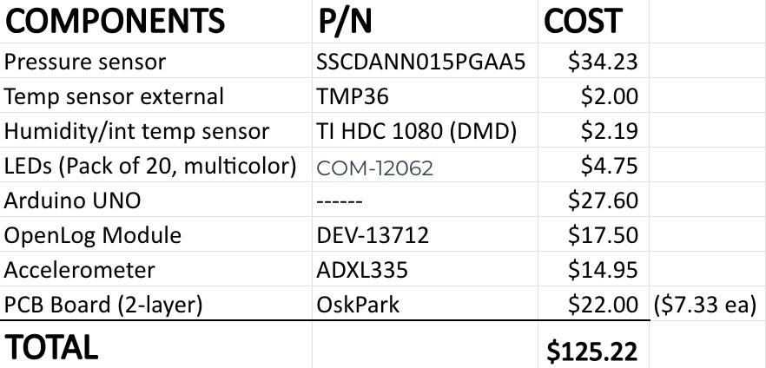
Phase 2: Components & Cost Breakdown
*NOTE:
Estimate made under the assumption that basic materials such as soldering kit, wires, resistors, and headers are provided.

Slide 9
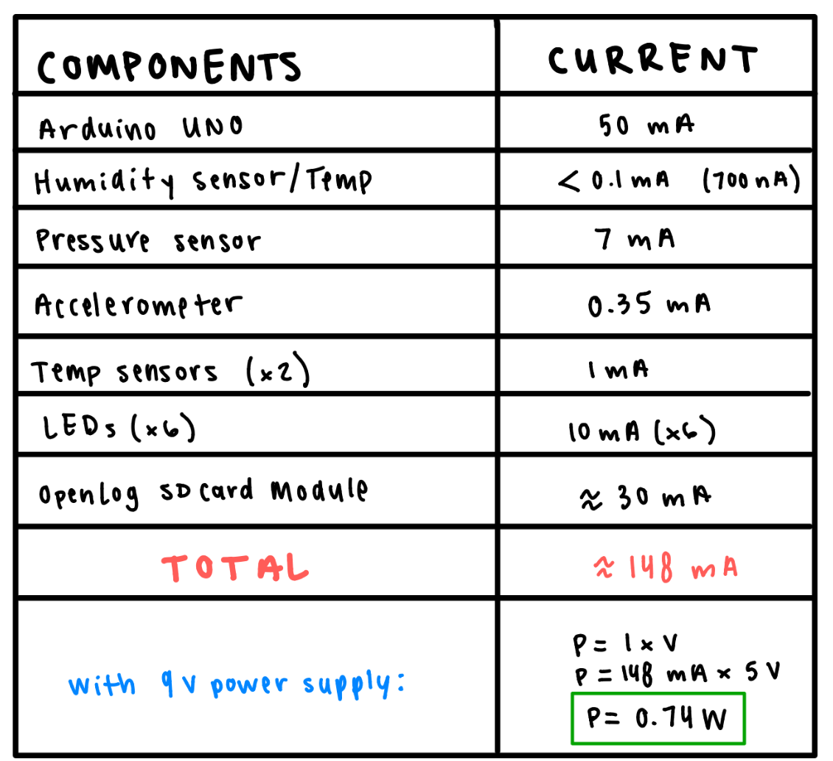
Phase 2: Power Consumption
Estimated current draw for each component
Not much different than original design

Slide 10
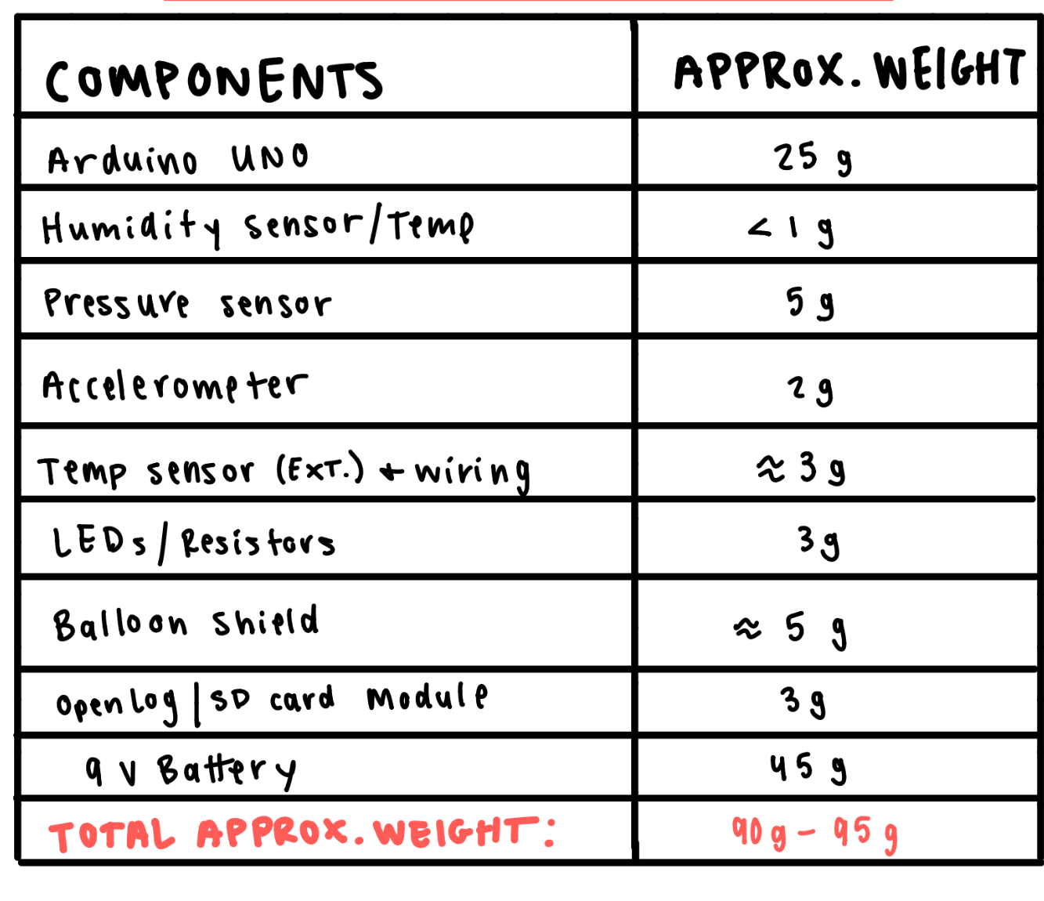
Phase 2: Total Weight Approx.
Total weight of onboard electronics: 90g - 95g

Slide 11
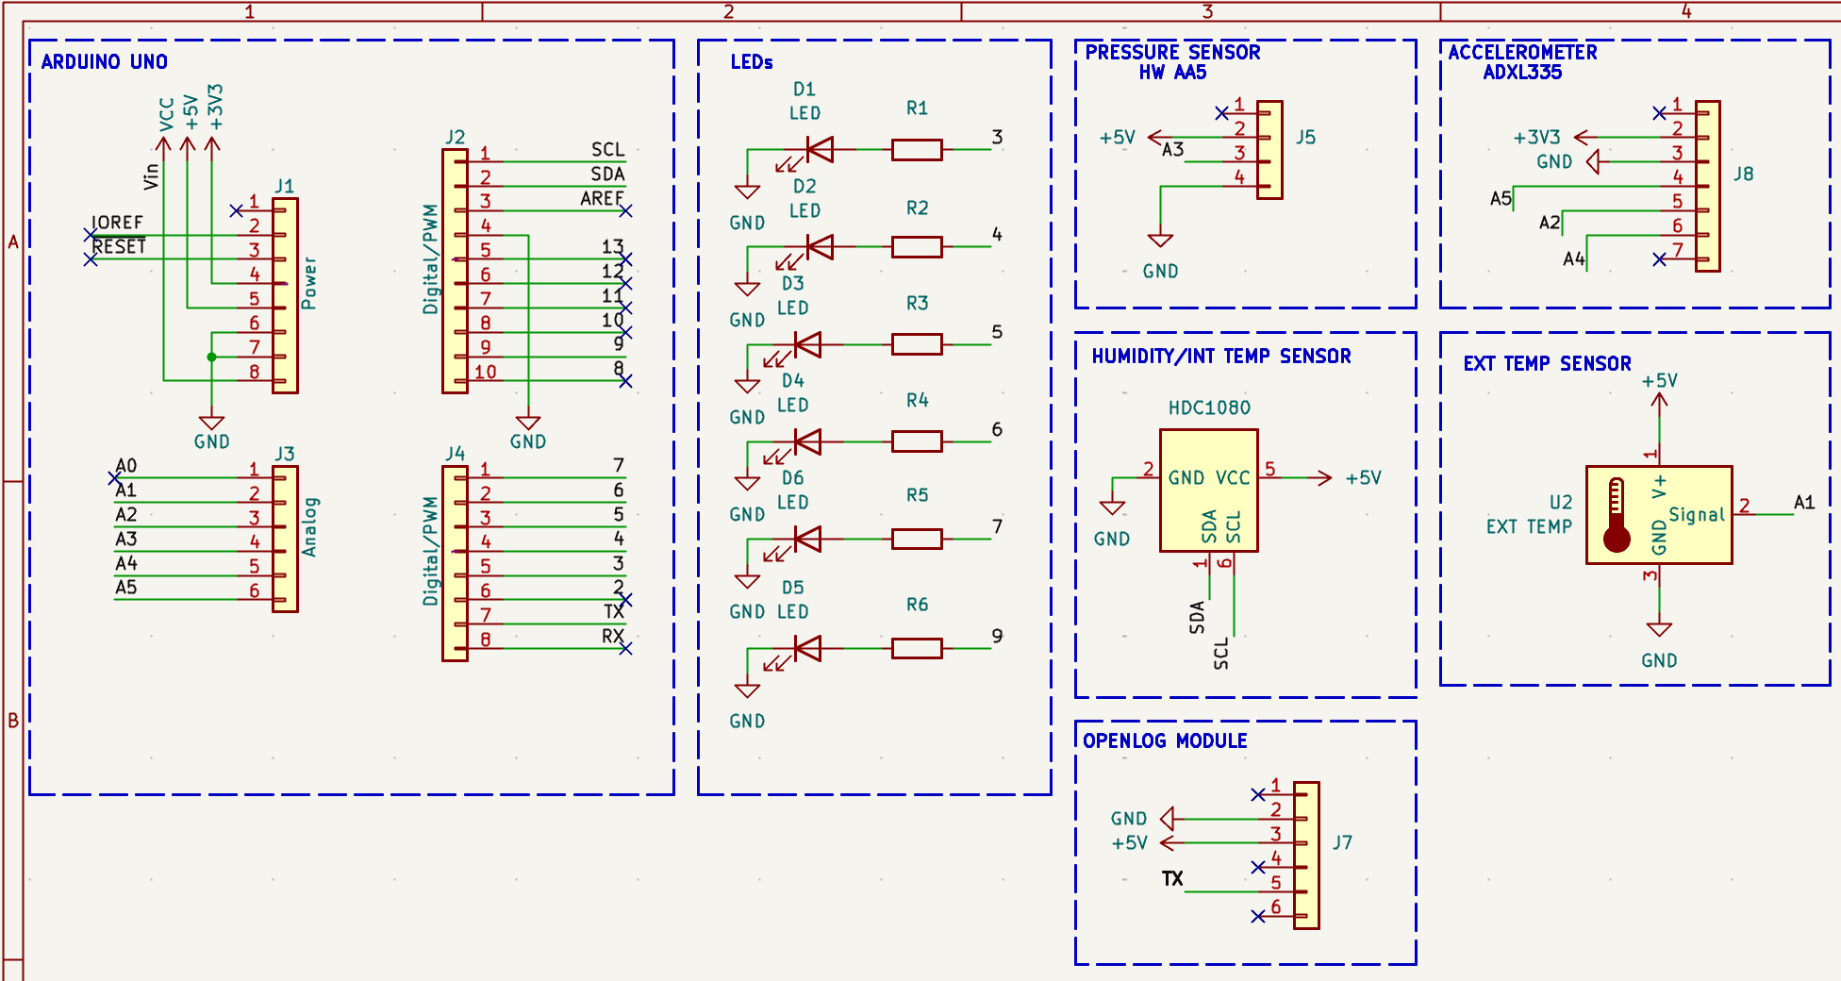
Schematics

Slide 12
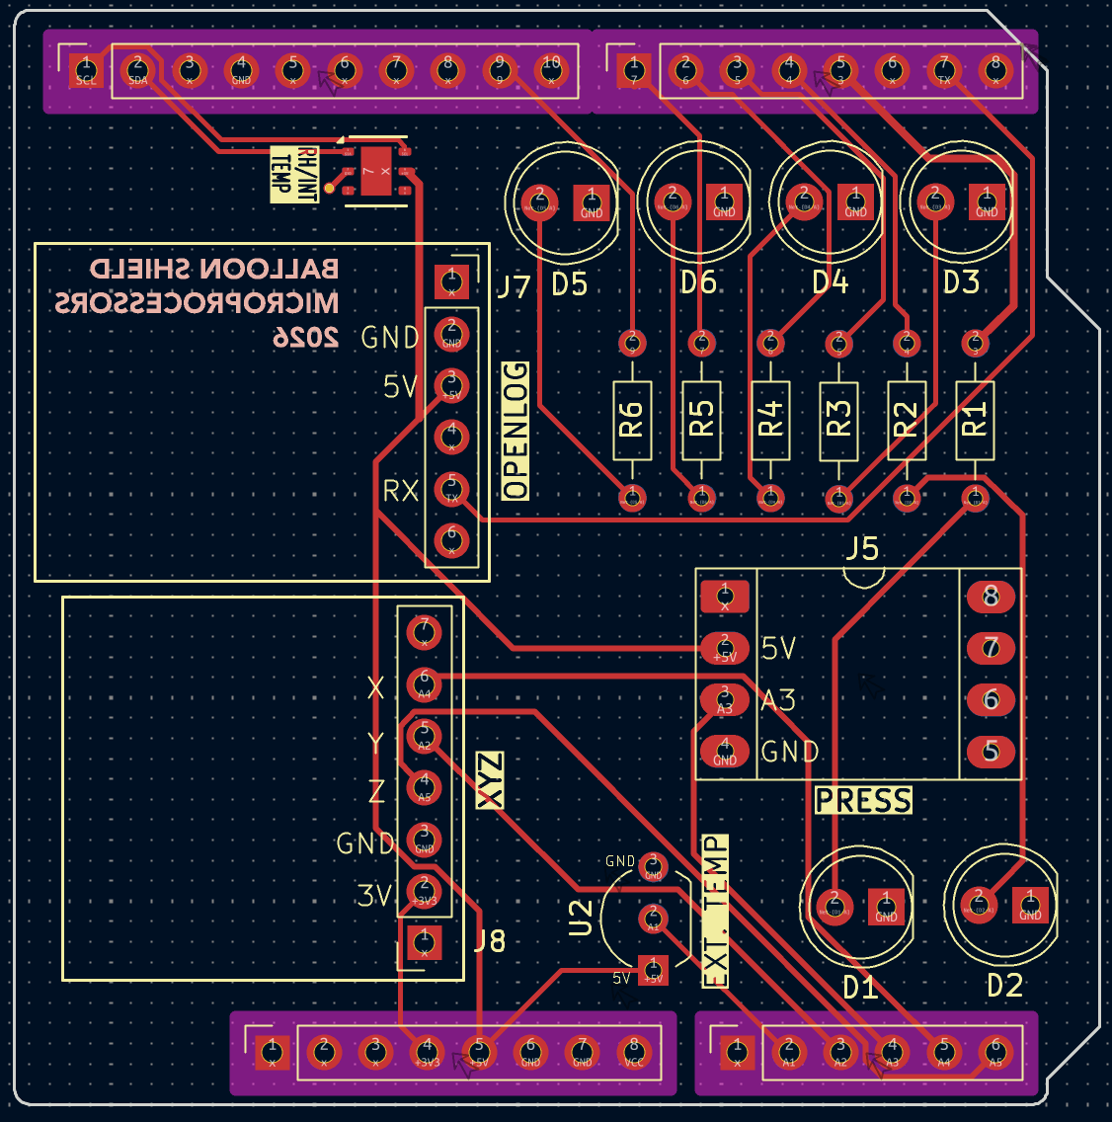
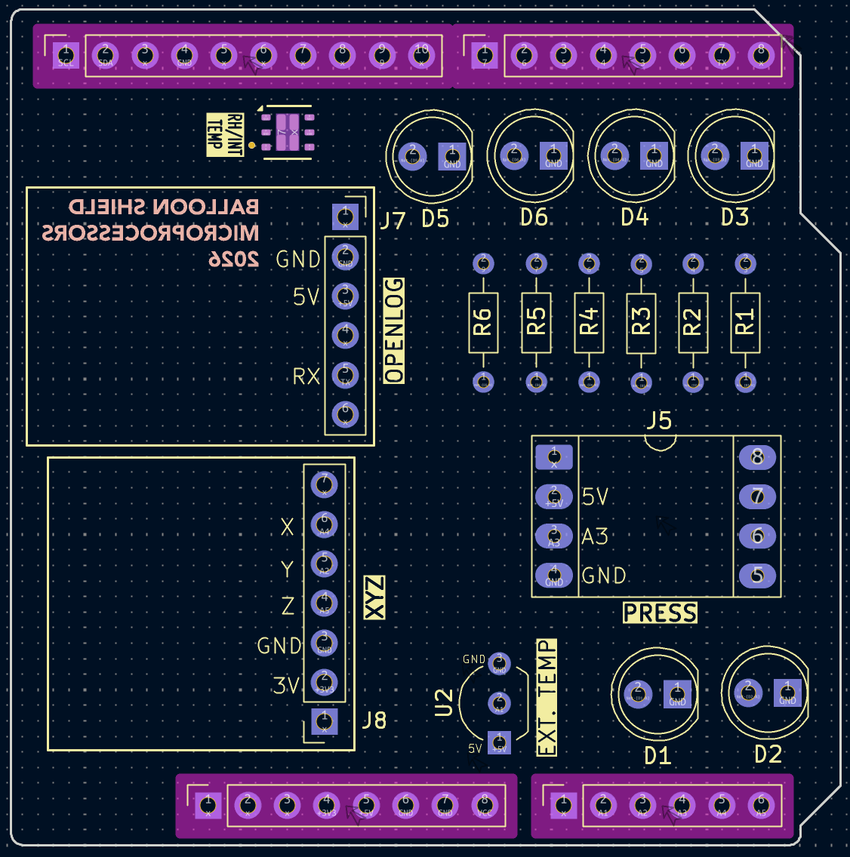
PCB Layout

Slide 13
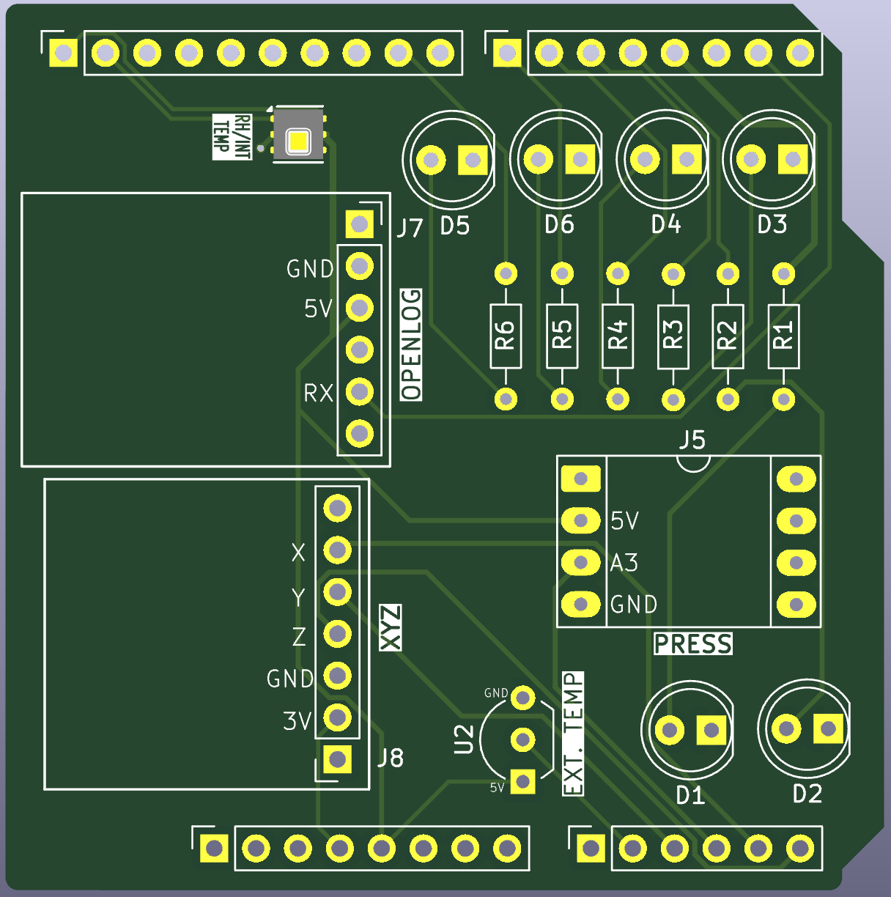
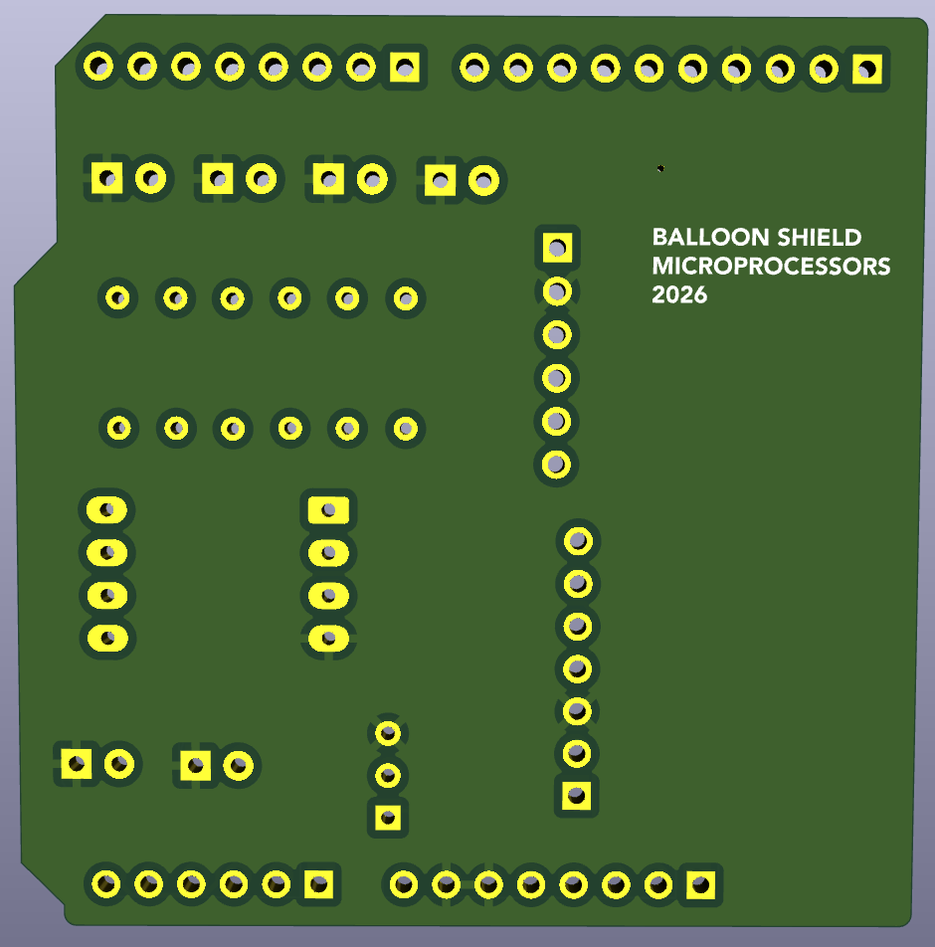
PCB 3D Render

Slide 14
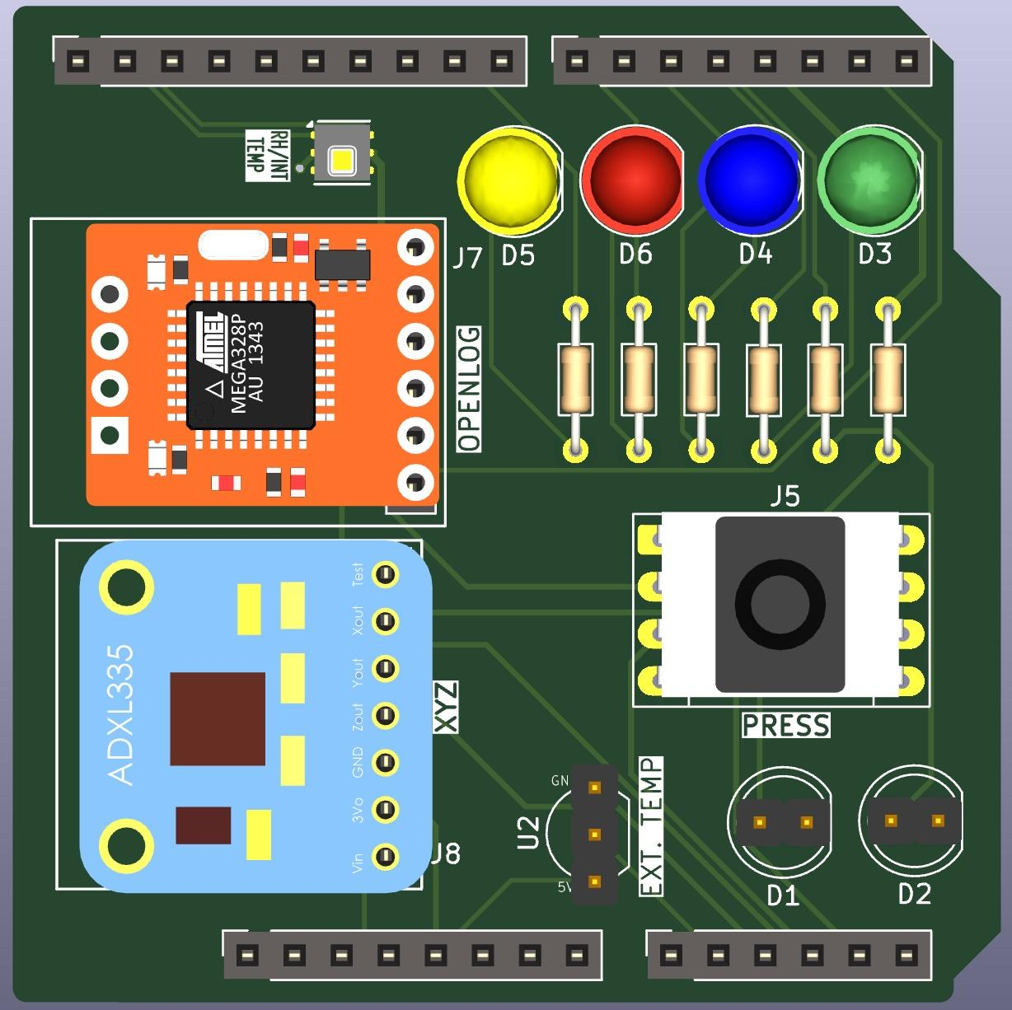
PCB 3D Render

Slide 15


December 11, 2025
Q&A
Any questions?
GitHub Repository linked below. Scan QR code.
https://github.com/laurenoo/ENCE_3210_Lauren_Ooghe_2026/tree/main/Documentation_D
Notes:
Anything anyone would like to add, any concerns?

